Slide 1
Precipitation
All water enters the land phase of the hydrologic cycle as precipitation. Thus in order to assess, predict and forecast hydrologic responses hydrologists need to understand how the amount, duration, rate and quality of precipitation are distributed in time and space.

Slide 2
Water Vapor in the Atmosphere
The atmosphere a critical pathway in the hydrologic cycle
The transport and distribution of water vapor in the atmosphere controls precipitation and evaporation which in turn determine soil and groundwater storage and runoff

Slide 3
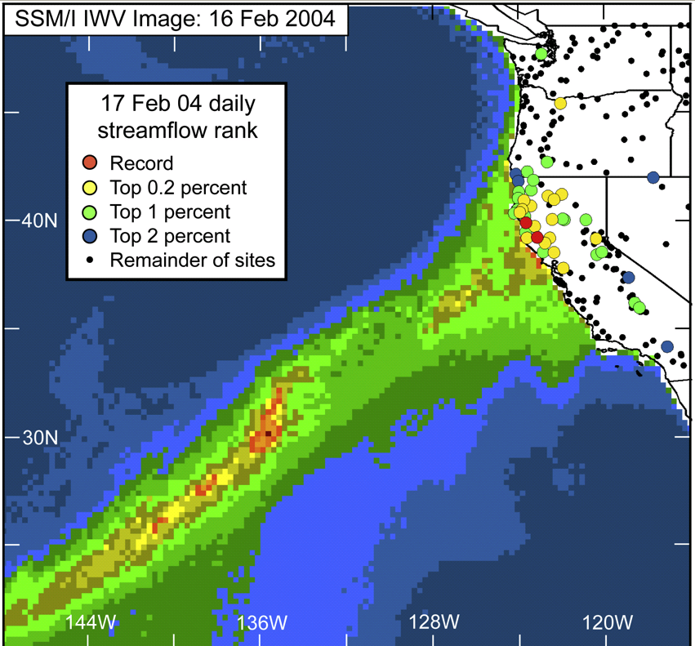
Ralph, F. M., P. J. Neiman, G. A. Wick, S. I. Gutman, M. D. Dettinger, D. R. Cayan, and A. B. White (2006), Flooding on California's Russian River: Role of atmospheric rivers, Geophys. Res. Lett., 33, L13801, doi:10.1029/2006GL026689.

Slide 4
Learning objectives
Describe the physical processes involved in the formation of precipitation
Identify and describe the meteorological patterns that give rise to precipitation in different parts of the world
Reading
Dingman Chapter 4

Slide 5
Meteorology of Precipitation
Precipitation requires
Cooling to below dew point
Condensation nuclei
Drop growth
Primary cooling mechanism is uplift
Precipitation amounts frequently larger than precipitable water
Requirement for supply of water vapor
Convergence and uplift
Weather systems
Extratropical cyclone/frontal system
Intertropical convergence zone
Hurricane
Convection (Thunderstorms) following surface heating.
Orography

Slide 6
From Dingman, 1994

Slide 7
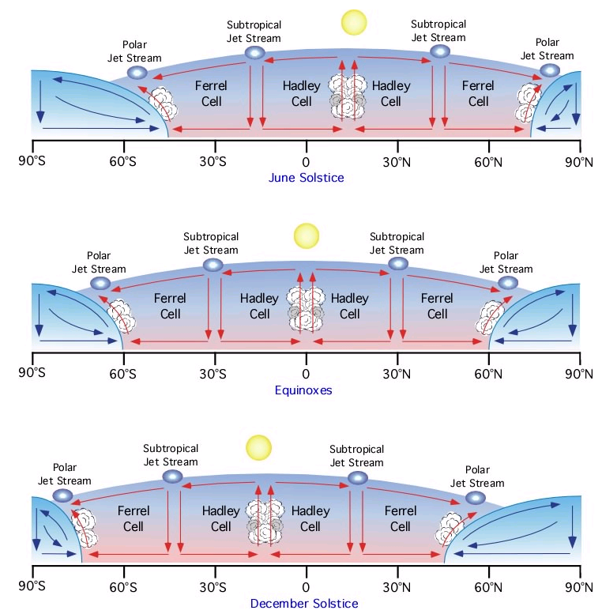
Seasonal movement of the Earth's global circulation patterns.
Pidwirny, M. (2006). "Tropical Weather and Hurricanes". Fundamentals of Physical Geography, 2nd Edition. Viewed 9/22/08. http://www.physicalgeography.net/fundamentals/7u.html

Slide 8
From Brutsaert, 2005

Slide 9
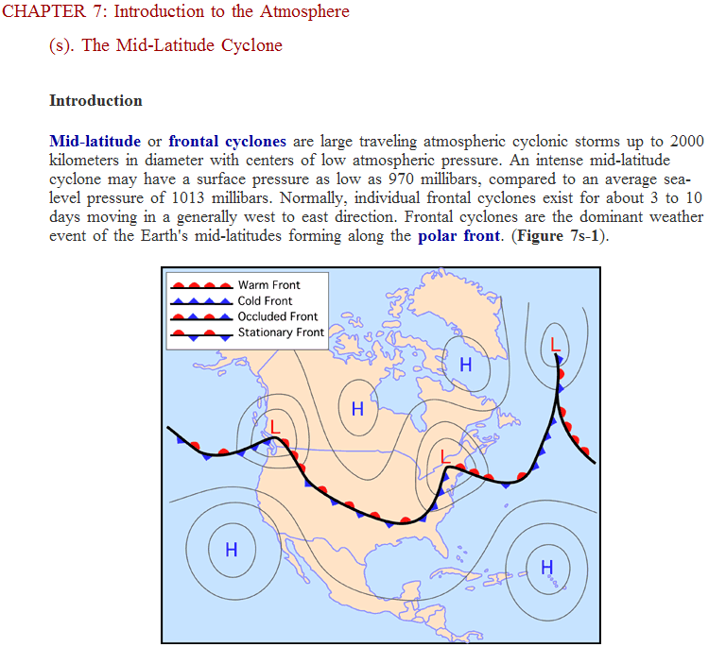
From http://www.physicalgeography.net/fundamentals/7s.html

Slide 10
From Bras, 1990
From Dingman,1994

Slide 11
From Dingman,1994

Slide 12
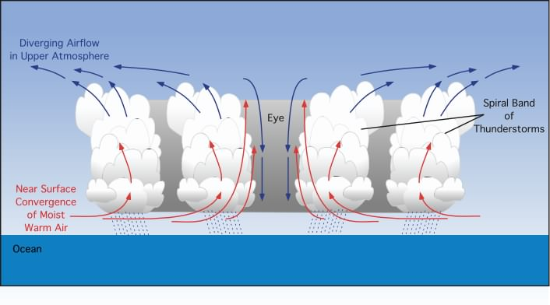

Hurricane Floyd, September 15, 1999
Graphical model showing a vertical cross-section of the air circulation, clouds, and precipitation associated with a hurricane.
From http://www.physicalgeography.net/fundamentals/7u.html

Slide 13
From Bras, 1990

Slide 14
From Brutsaert, 2005

Slide 15
Precipitation Measurement and Data Analysis
Learning objectives
Be able to estimate area average precipitation from point measurements using a variety of methods
Estimate design rainfall amounts and intensities
Develop ArcGIS skills for analysis of precipitation

Slide 16
Precipitation measurement at a point
Accuracy is an important foundation for quantitative hydrologic analysis
Issues affecting precipitation measurement accuracy (gage design considerations)
(Dingman p105-115)
Orifice size
Orifice orientation
Height above ground
Wind shielding
Obstructions (buildings, trees etc.)
Splashing (in or out)
Evaporation of collected water

Slide 17
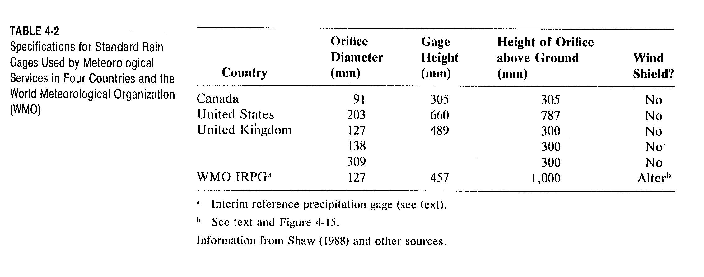
Standard Rain Gage Specifications
From Dingman, 1994

Slide 18
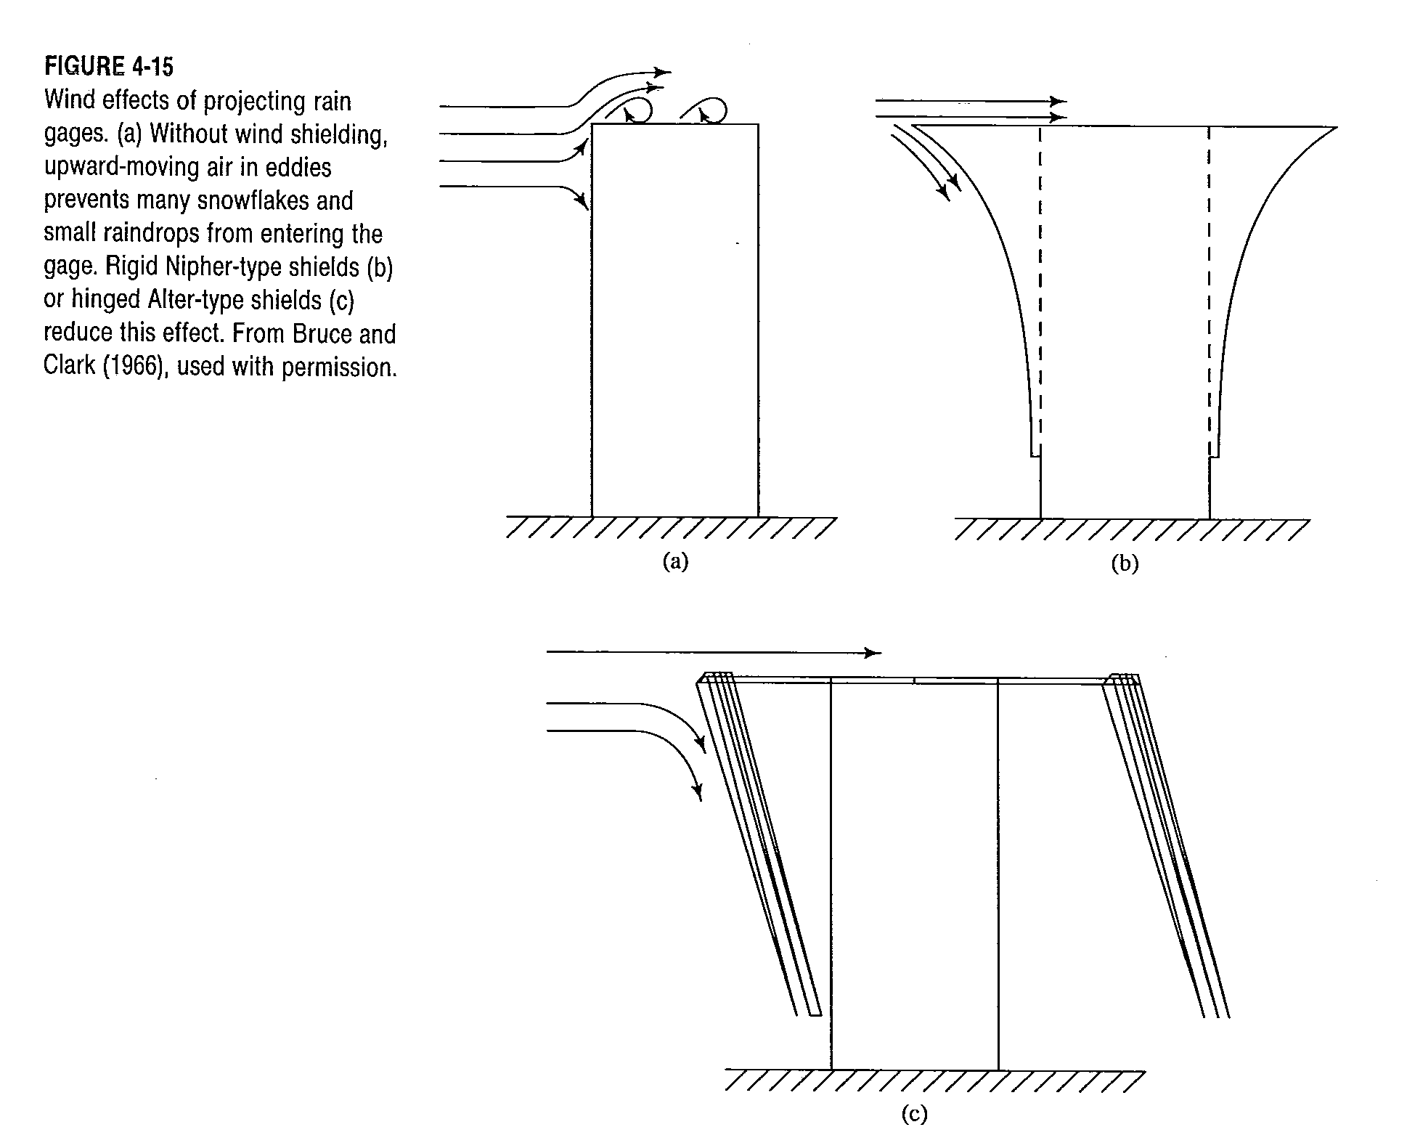
Wind effects and shields
From Dingman, 1994

Slide 19
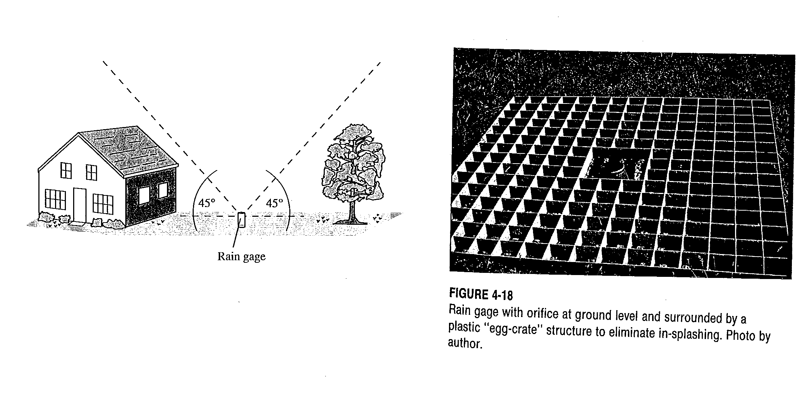
Avoid obstructions to gages. Reduce splash effects
From Dingman, 1994

Slide 20
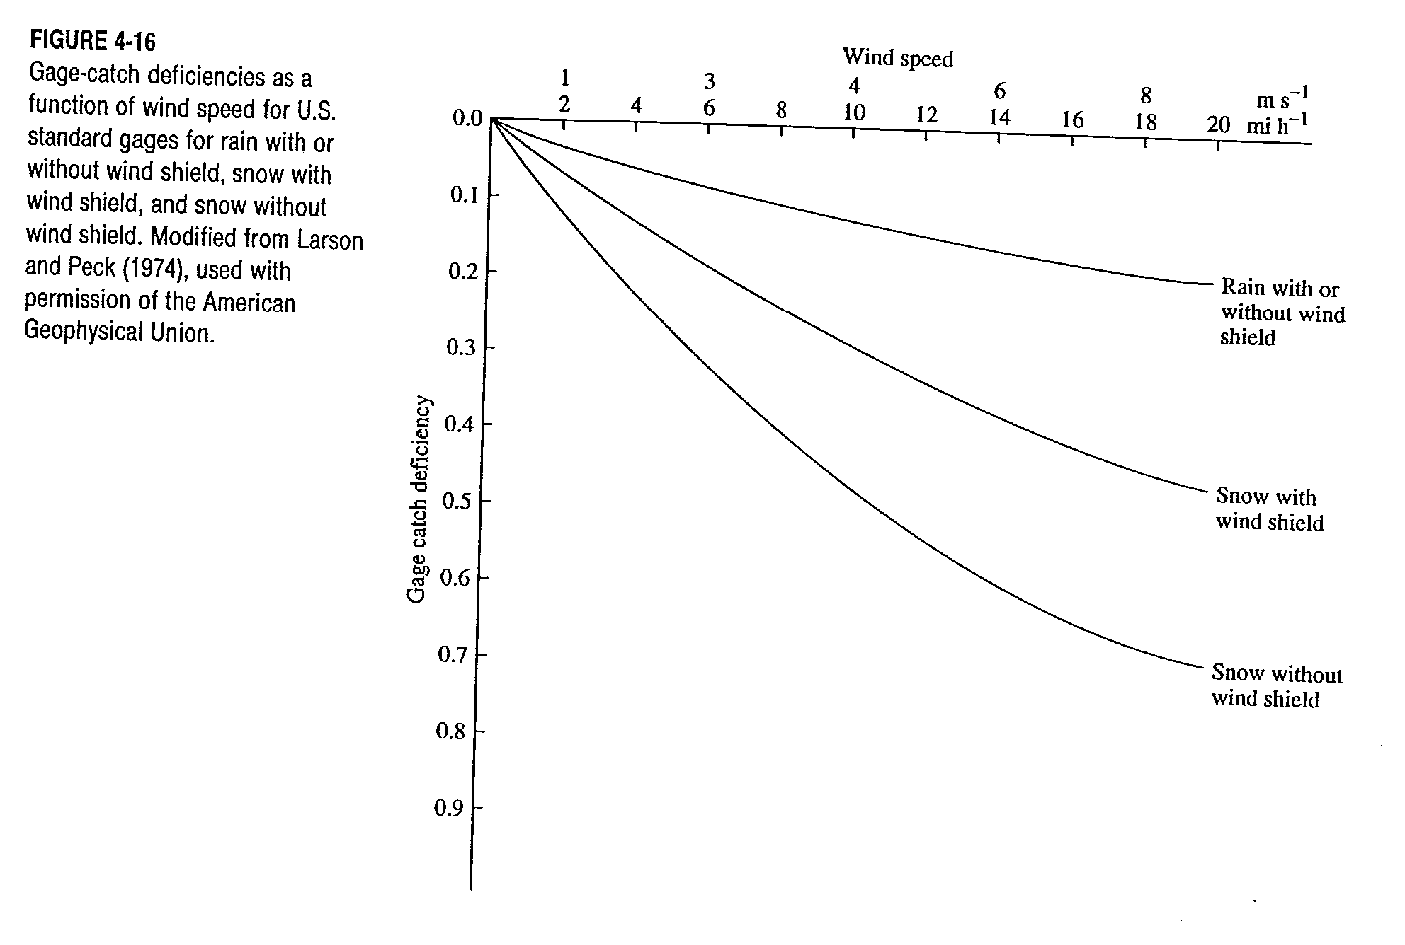
Gage-catch deficiencies
From Dingman, 1994

Slide 21
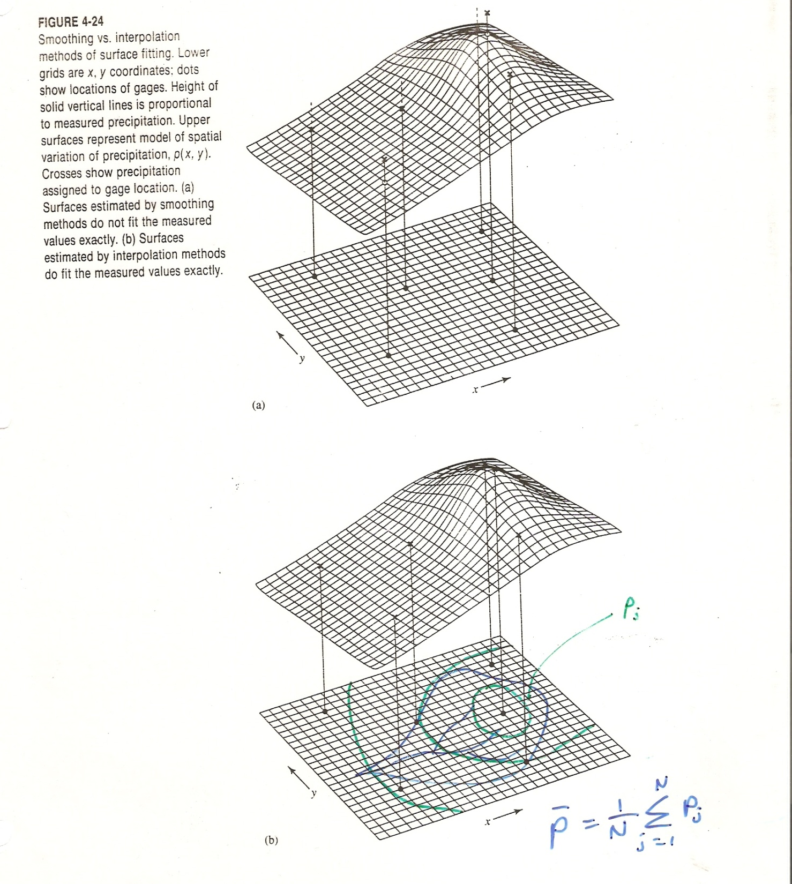
Precipitation area averaging
From Dingman, 1994

Slide 22
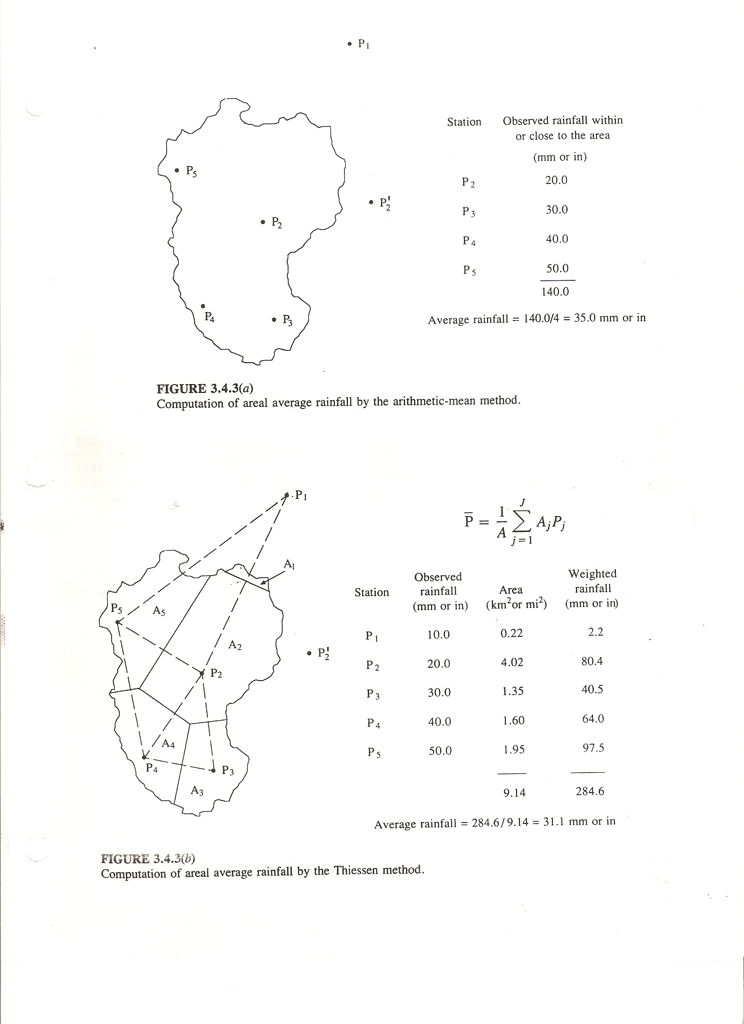
Arithmetic Average
From Dingman, 1994

Slide 23
Thiessen Polygons
From Dingman, 1994

Slide 24
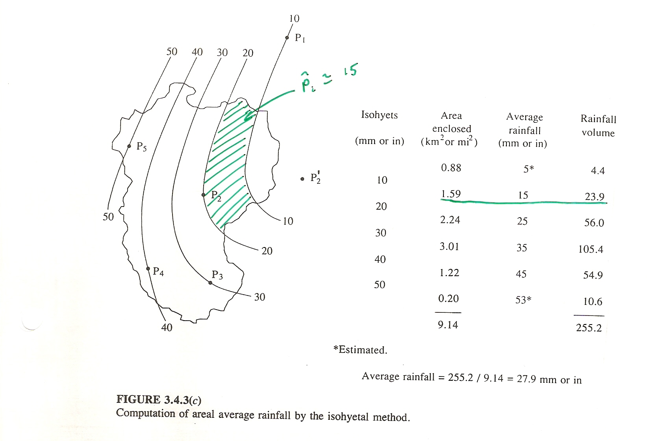
Isohyetal method
From Dingman, 1994

Slide 25
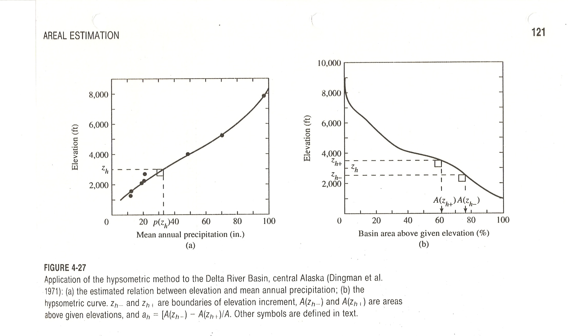
Hypsometric Method
From Dingman, 1994

Slide 26
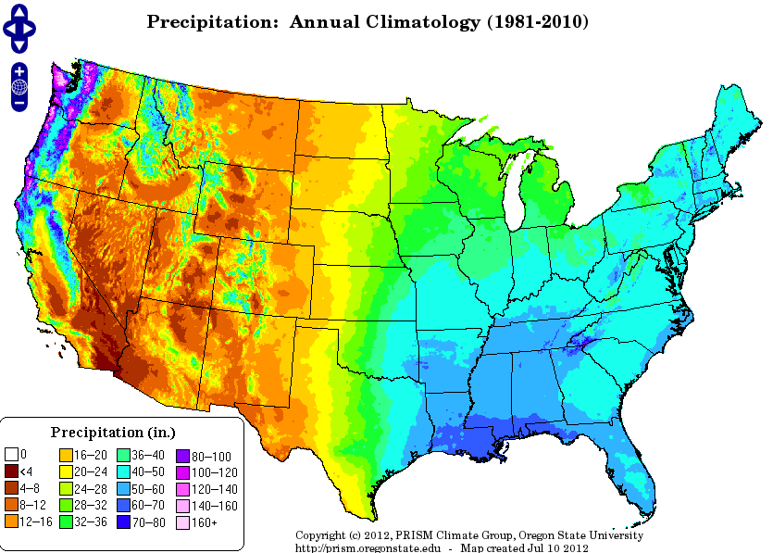
From www.prism.oregonstate.edu

